Slide 1

New York City Crime Analysis
New York City Crime Analysis (2017-2021)
By Jewel Irvin, Harry Mecouch, Nicholas DeMarco
By Jewel Irvin, Nicholas De-Marco, Harry Mecouch

Slide 2
Project Overview
This project aims to explore and analyze the NYPD Arrests dataset to identify trends and insights about arrests in New York City. The dataset contains information about arrests made in NYC from 2017 to 2021, including the date of the arrest, the crime committed, demographic information about the perpetrator, and information about the arrest location.
To analyze the data, we will perform a series of data cleaning and preprocessing steps to prepare the data for analysis. We will then perform exploratory data analysis to identify trends and patterns in the data and formulate questions that we would like to answer. Finally, we will build a Random Forest Classifier model to predict the level of offense of an arrest (felony or misdemeanor), and store the cleaned data in a Postgres database.

Slide 3
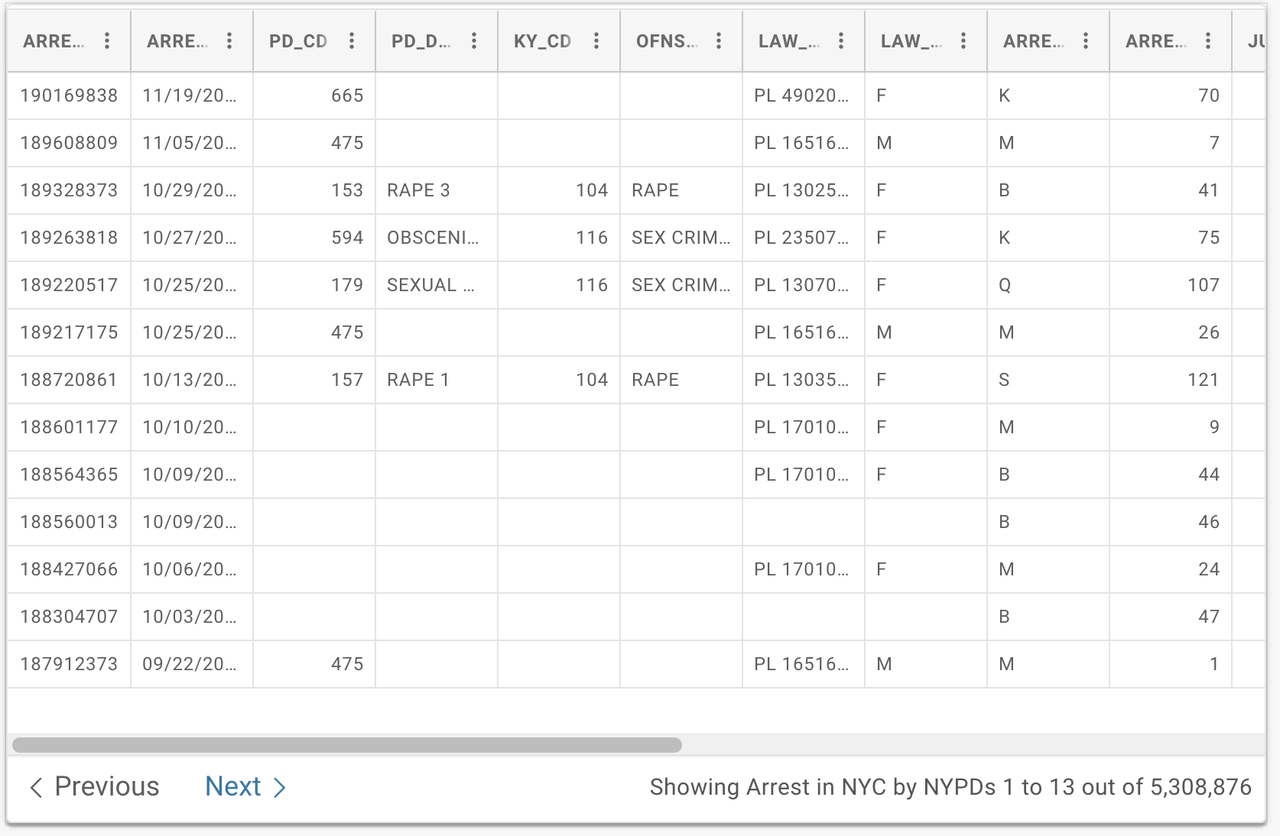
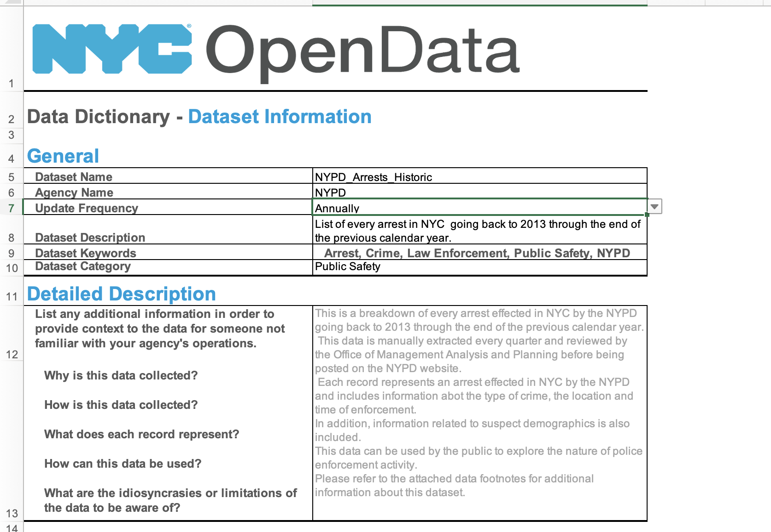
Data Source
We used an official dataset that intakes every arrest of the NYPD dating back to 2006 through the end of last year. The dataset updates annually by Police Department (NYPD).
https://data.cityofnewyork.us/Public-Safety/NYPD-Arrests-Data-Historic-/8h9b-rp9u

Slide 4
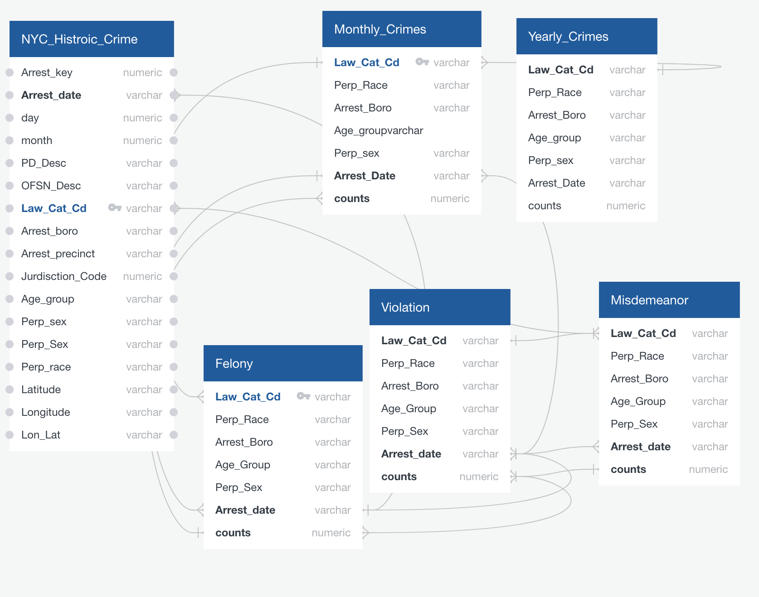
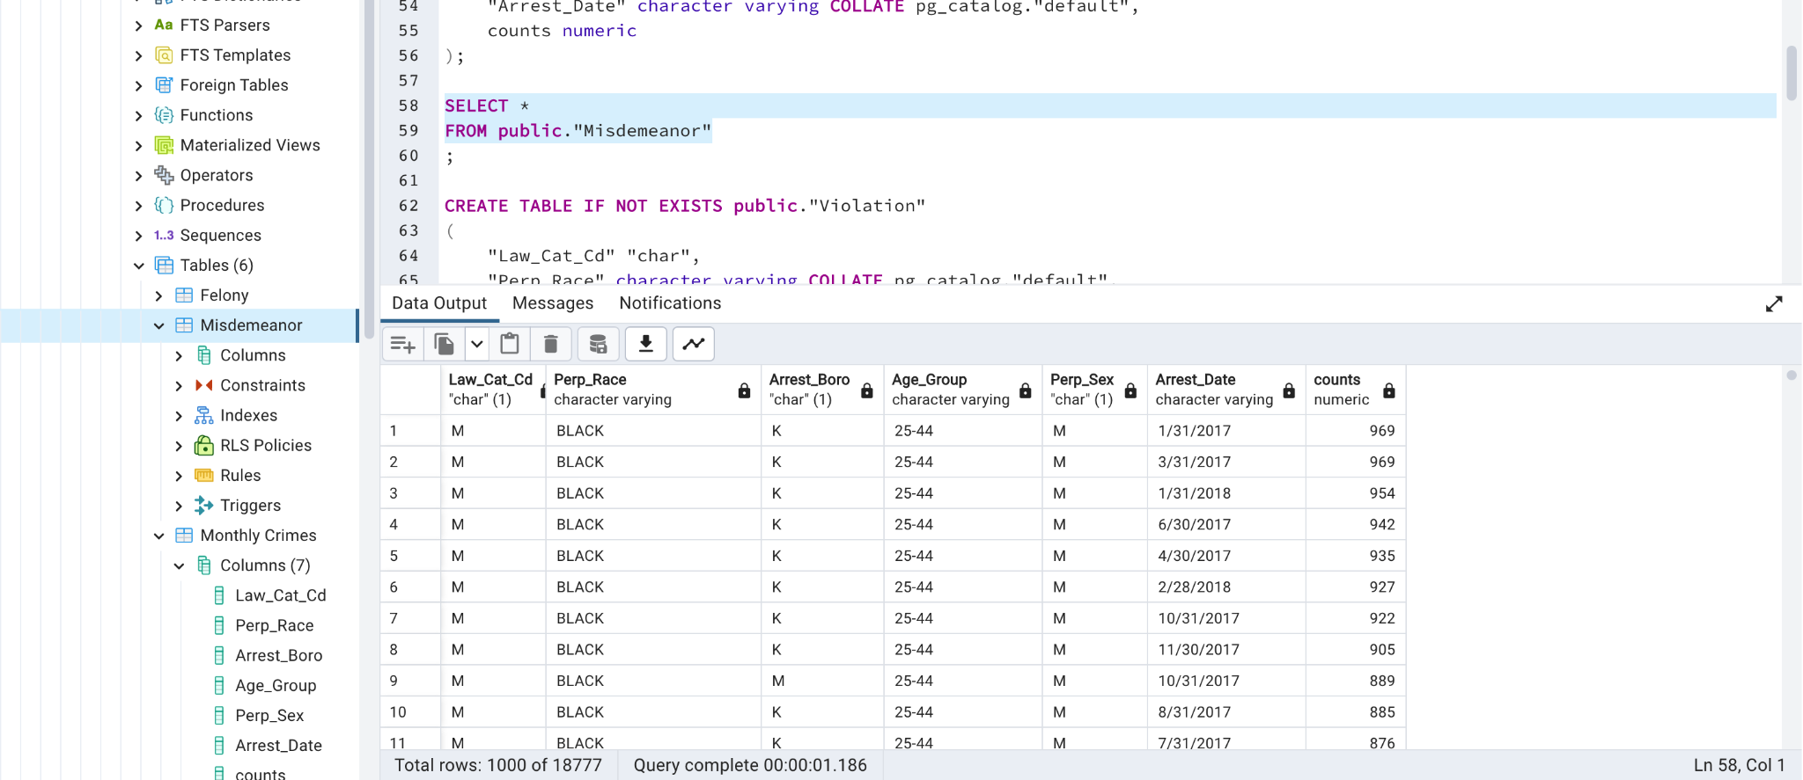
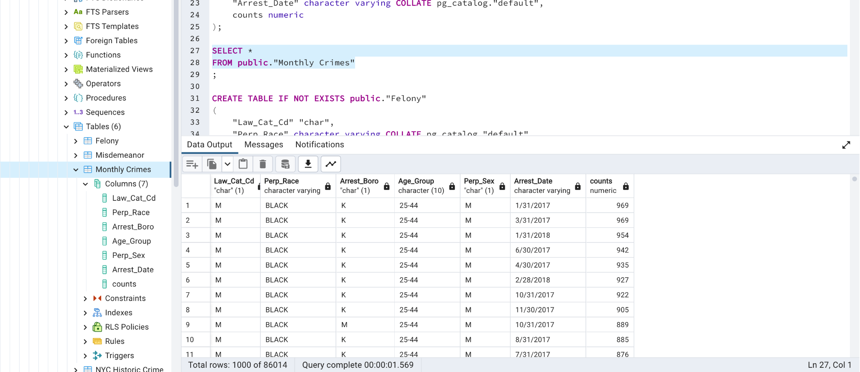
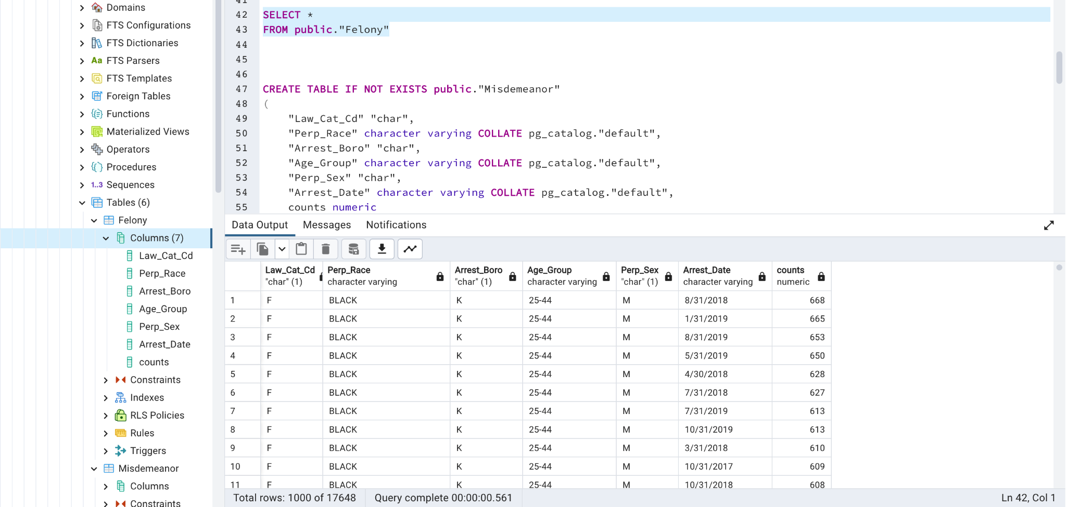
Database Portion
A PostgreSQL relational database was utilized for data storage due to its ability to easily establish connections between various tables and generate results that can answer questions. Additionally, the unchanging nature of the database enables it to be seamlessly integrated with Pandas for executing ETL processes.
Tables:
Felony
Misdemeanor
Monthly Crimes
Yearly Crimes
Violations

Slide 5
Cleaning Data / Data Exploration Phase
The first step in this project was to clean and preprocess the dataset. This involved dropping unnecessary columns, handling missing data, and encoding categorical variables. The following steps were taken to clean the data.
- Dropped unnecessary columns such as arrest date, arrest key, jurisdiction code, latitude, longitude, and description columns.
- Handled missing data by dropping rows with missing values.
- Encoded categorical variables such as borough of arrest, age group, race, sex, and level of offense using LabelEncoder from the sklearn library.
After cleaning the data, exploratory data analysis was performed to gain insights into the dataset and visualize the distribution of the target variable. The following analyses were performed:- Checked the distribution of the target variable (level of offense) and found that it was imbalanced, with a majority of the arrests being for misdemeanors and felonies.

Slide 6
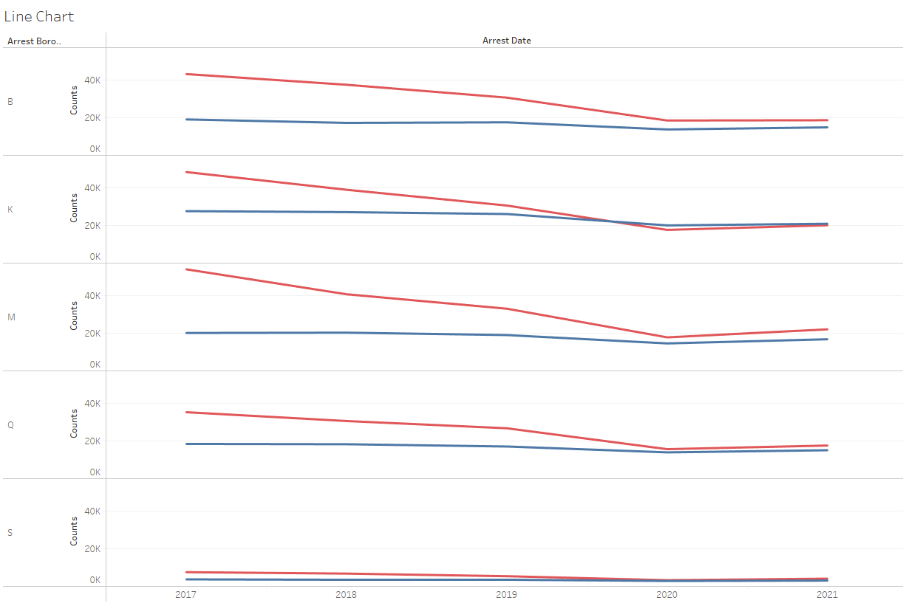
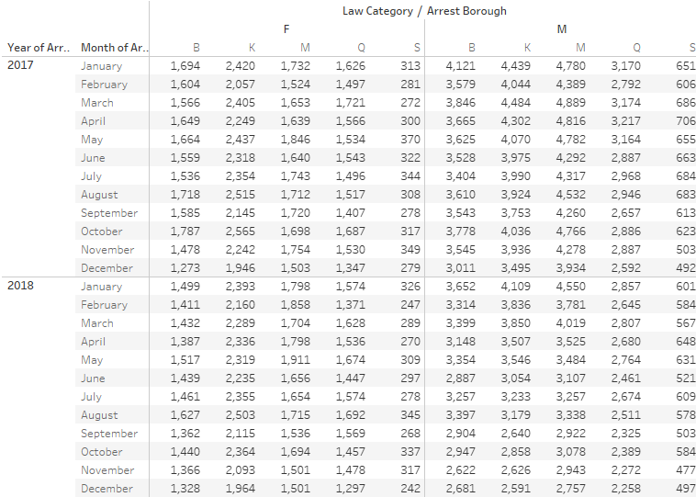
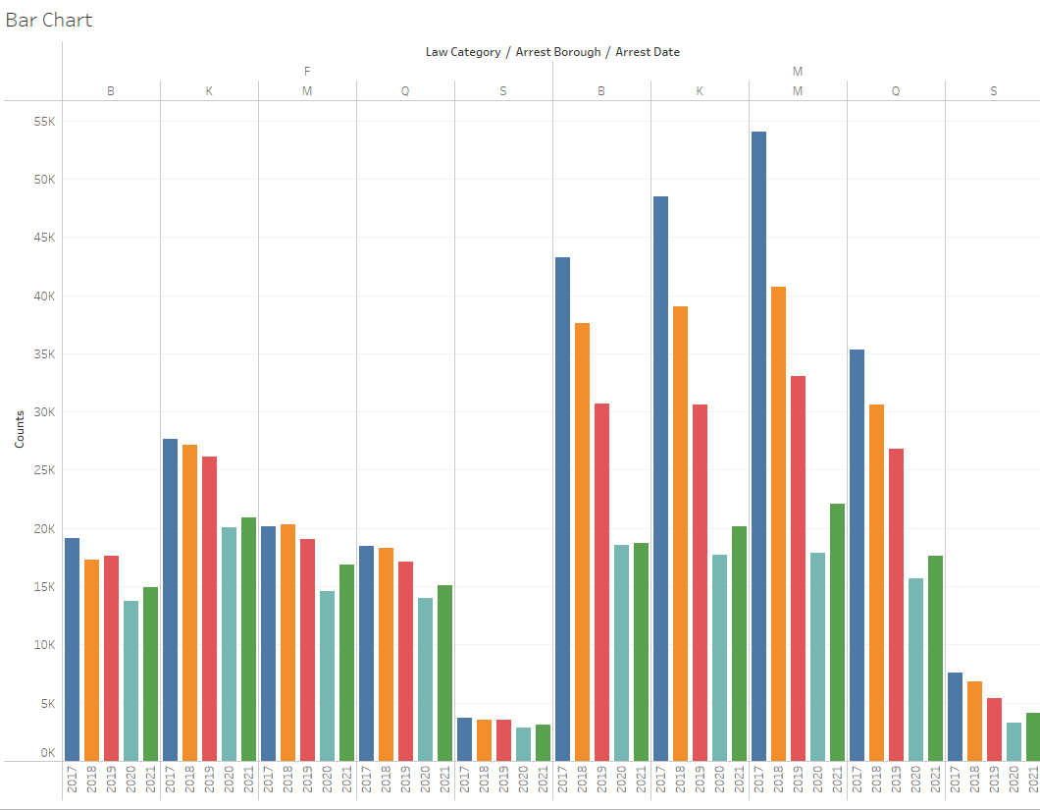
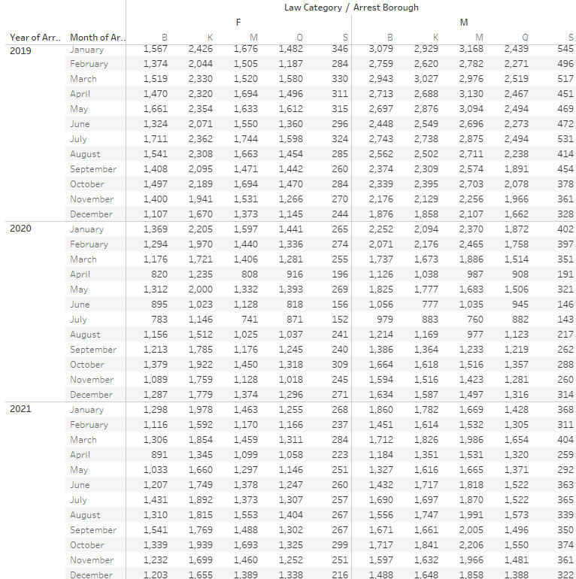
Dashboard/ Visualizations

Slide 7
Machine Learning Portion
-The goal of this portion of the analysis was to train a machine learning model to predict whether an arrest resulted in a misdemeanor or a felony.
-To achieve this goal, I used a ML approach that involved training a Random Forest Classifier on the demographic features of the arrestees and the boro of the arrest.
-The result of the analysis show that the RFC model achieved an accuracy score of .62, meaning the model correctly predicted the class for approximately 62% of the observations.
-In conclusion, the analysis showed that an RFC model trained on demographic features of NYC arrestees had difficulty distinguishing between the two law categories. This indicates that further analysis and experimentation may be necessary to improve its performance and gain a more nuanced understanding of the factors that contribute to arrest outcomes in NYC.

Slide 8
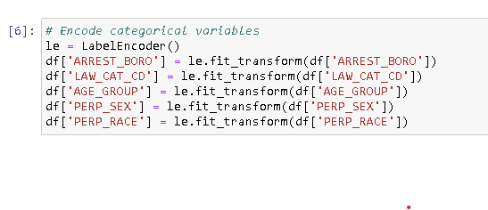
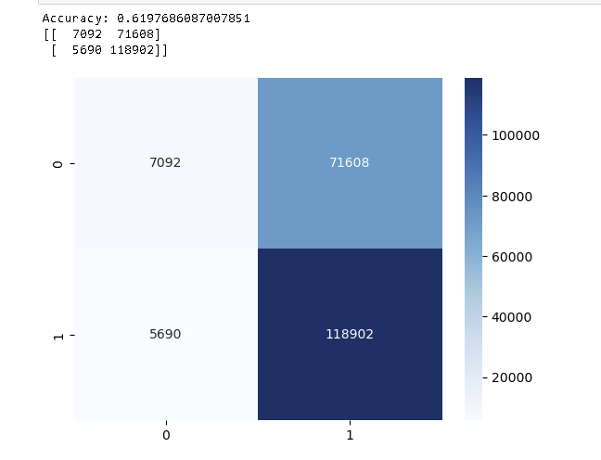

Slide 9
Results of Analysis/ Recommendations
The data shows that felonies have remained relatively stable over time. The data shows a sharp decline in misdemeanors from 2017 to 2019. This could be because felonies are typically more serious crimes that require more extensive investigation and prosecution, and therefore may not be as affected by changes in policing strategies or changes in societal behaviors. Additionally, the types of crimes that are classified as felonies may not have changed significantly over the years, which could also explain the stable trend.
While there may not be a direct correlation between the decline in misdemeanors and the stable trend in felonies, there are several possible factors that could be contributing to both trends. For example, changes in policing strategies and changes in societal norms and behaviors could be impacting both the number of misdemeanors and the types of felonies being committed. It is also possible that changes in the legal system, such as changes in sentencing guidelines or diversion programs, could be influencing both trends. Further analysis would be necessary to determine the extent of the correlation, if any.
COVID-19 is likely to have played a significant role in the decline of misdemeanors over time. The pandemic led to a number of changes in daily life, including the implementation of lockdowns and social distancing measures, which likely resulted in a decrease in public gatherings and activities. This may have resulted in a decrease in the likelihood of committing misdemeanors, such as disorderly conduct, loitering, or minor drug offenses, which often occur in public spaces.
New Question: where are the most popular hotspots of crime in NYC, and what factors may be contributing to the spatial patterns of crime? By performing a hotspot analysis and identifying areas of high and low crime rates, we can develop a more nuanced understanding of the spatial distribution of crime and identify potential causes and solutions.

